Slide 1

CHAPTER 9
COUNTING AND
PROBABILITY
Copyright © Cengage Learning. All rights reserved.

Slide 2
SECTION 9.7
Pascal’s Formula and the Binomial Theorem
Copyright © Cengage Learning. All rights reserved.

Slide 3

Pascal’s Formula and the Binomial Theorem
In this section we derive several formulas for values of .
The most important is Pascal’s formula, which is the basis
for Pascal’s triangle and is a crucial component of one of
the proofs of the binomial theorem.

Slide 4
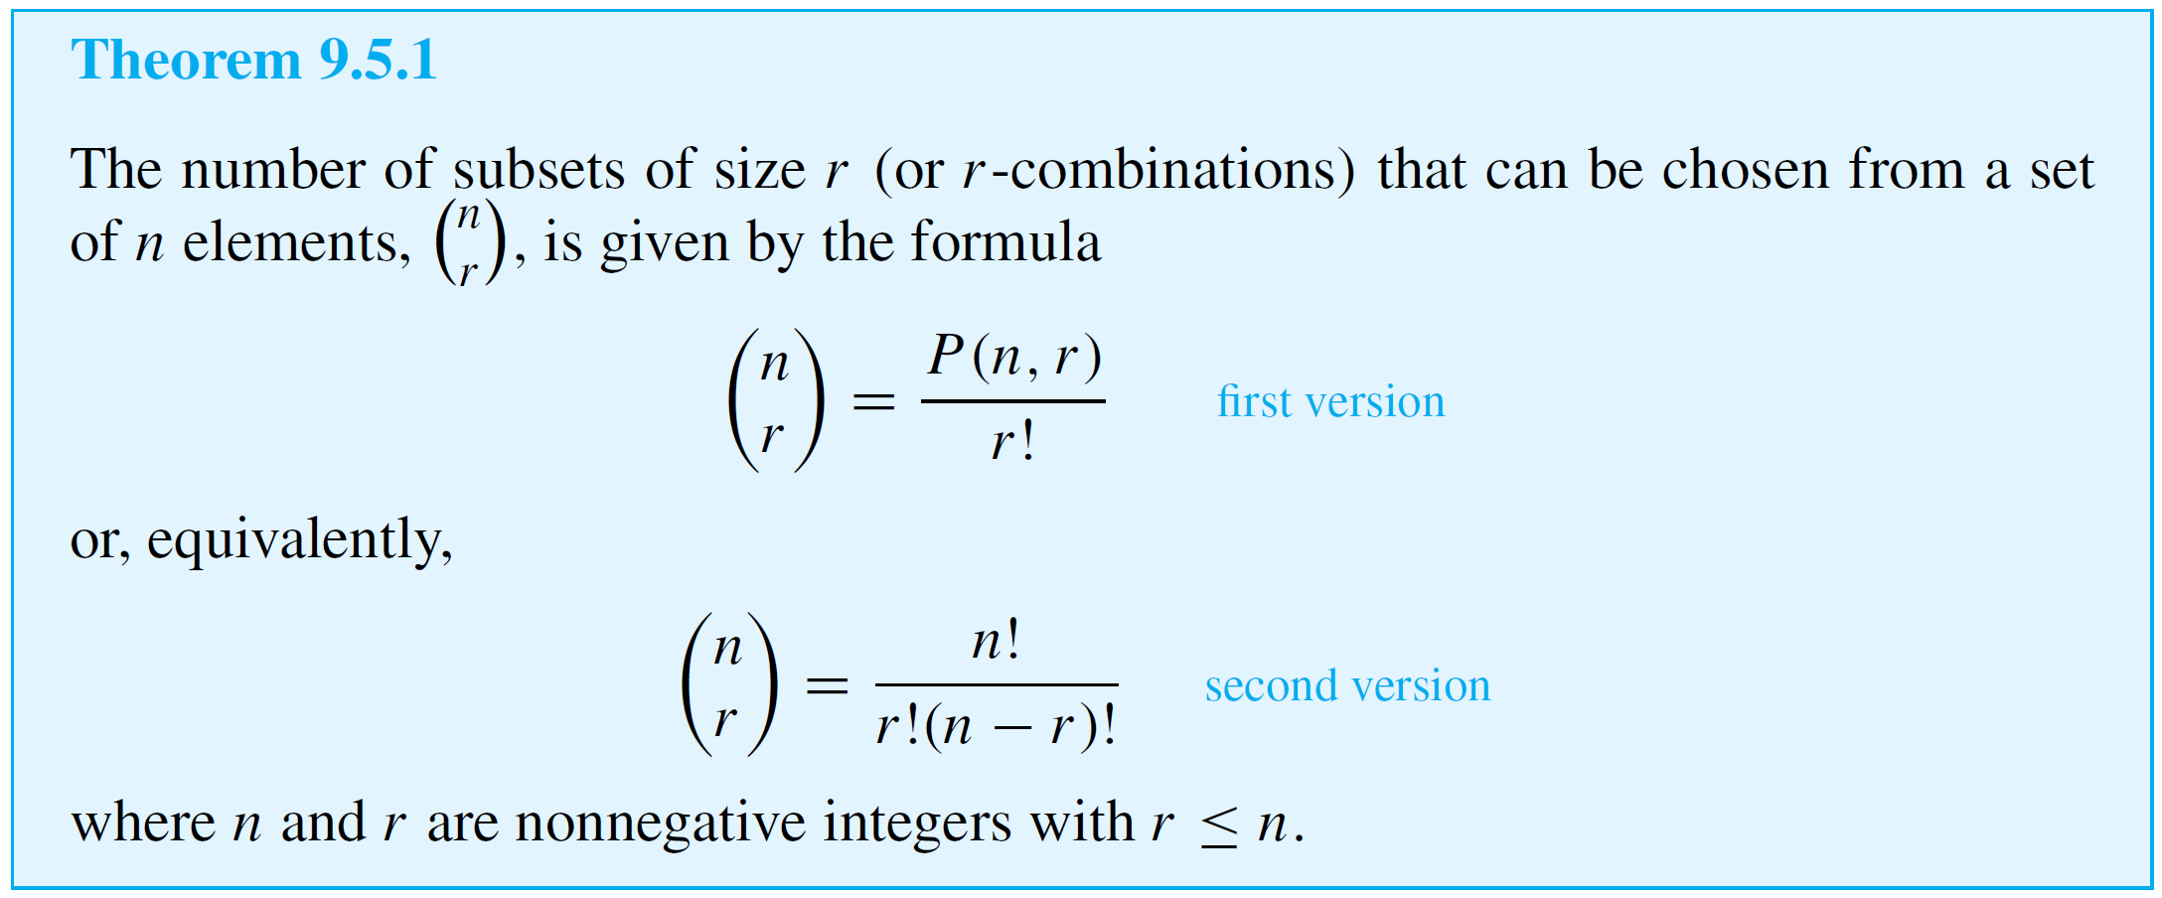
Example 1 – Values of ( ),( ),( )
n
n
n
n – 1
n
n – 2
Think of Theorem 9.5.1 as a general template.

Slide 5
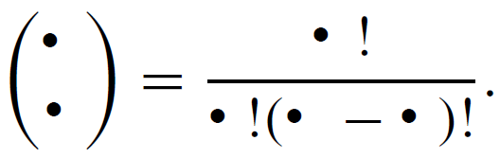
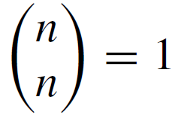

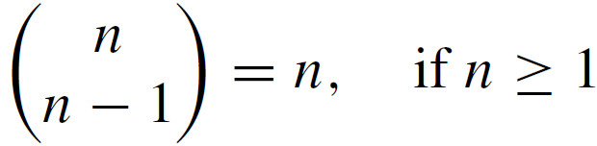

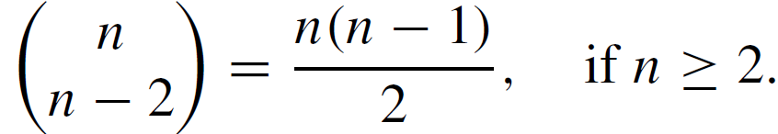

Example 1 – Values of ( ),( ),( )
n
n
n
n – 1
n
n – 2
cont’d
Regardless of what nonnegative numbers are placed in the boxes, if the number in the lower box is no greater than the number in the top box, then
Use Theorem 9.5.1 to show that for all integers n ≥ 0,

Slide 6
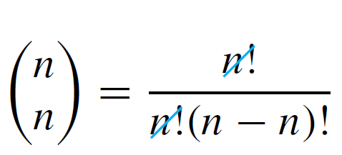
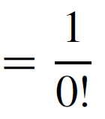

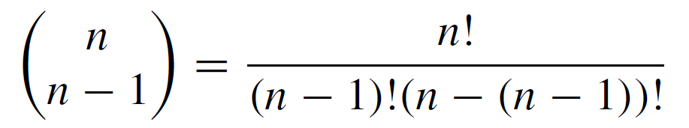
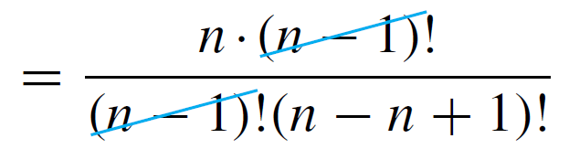
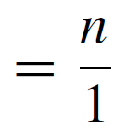
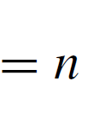
Example 1 – Solution

Slide 7
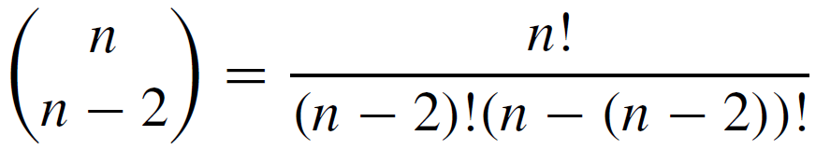
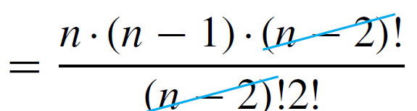
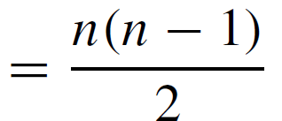
Example 1 – Solution
cont’d

Slide 8
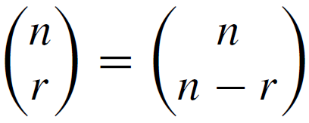
Example 2 – ( ) = ( )
n
r
n
n – r
Deduce the formula for all nonnegative
integers n and r with r ≤ n, by interpreting it as saying that a set A with n elements has exactly as many subsets of size r as it has subsets of size n – r.

Slide 9
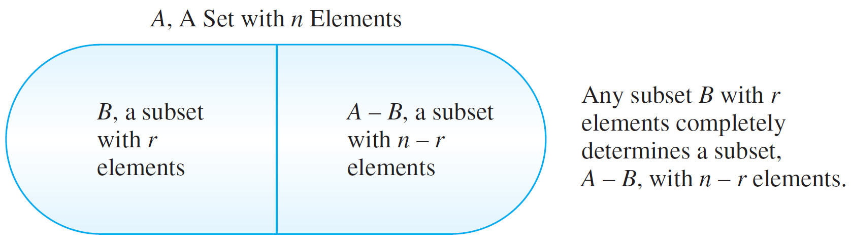
Example 2 – Solution
Observe that any subset of size r can be specified either by saying which r elements lie in the subset or by saying which n – r elements lie outside the subset.

Slide 10
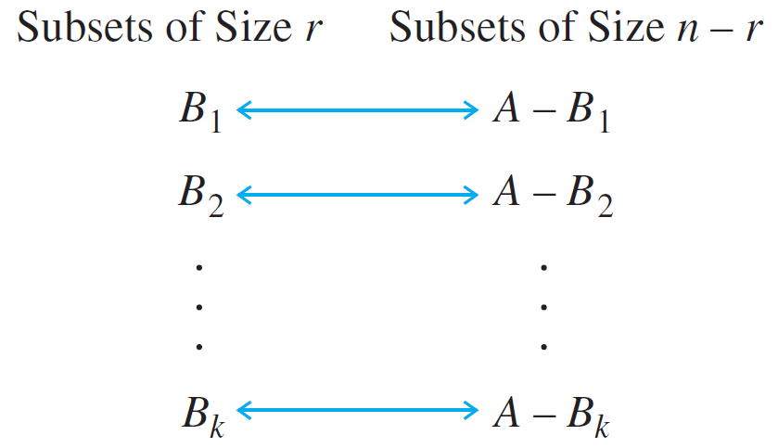
Example 2 – Solution
cont’d
Suppose A has k subsets of size r : B₁, B₂, . . . , B_{k}.
Then each B_{i} can be paired up with exactly one set of size n – r, namely its complement A – B_{i} as shown below.

Slide 11

Example 2 – Solution
cont’d
All subsets of size r are listed in the left-hand column, and all subsets of size n – r are listed in the right-hand column.
The number of subsets of size r equals the number of
subsets of size n – r, and so

Slide 12
Pascal’s Formula and the Binomial Theorem
The type of reasoning used in this example is called
combinatorial, because it is obtained by counting things
that are combined in different ways.
A number of theorems have both combinatorial proofs and proofs that are purely algebraic.

Slide 13
Pascal’s Formula

Slide 14
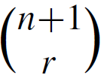

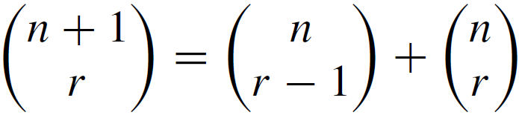

Pascal’s Formula
It relates the value of to the values of
Specifically, it says that
whenever n and r are positive integers with r ≤ n.
This formula makes it easy to compute higher combinations in terms of lower ones: If all the values of are known, then the values of can be computed for all r such that
0 < r ≤ n.

Slide 15
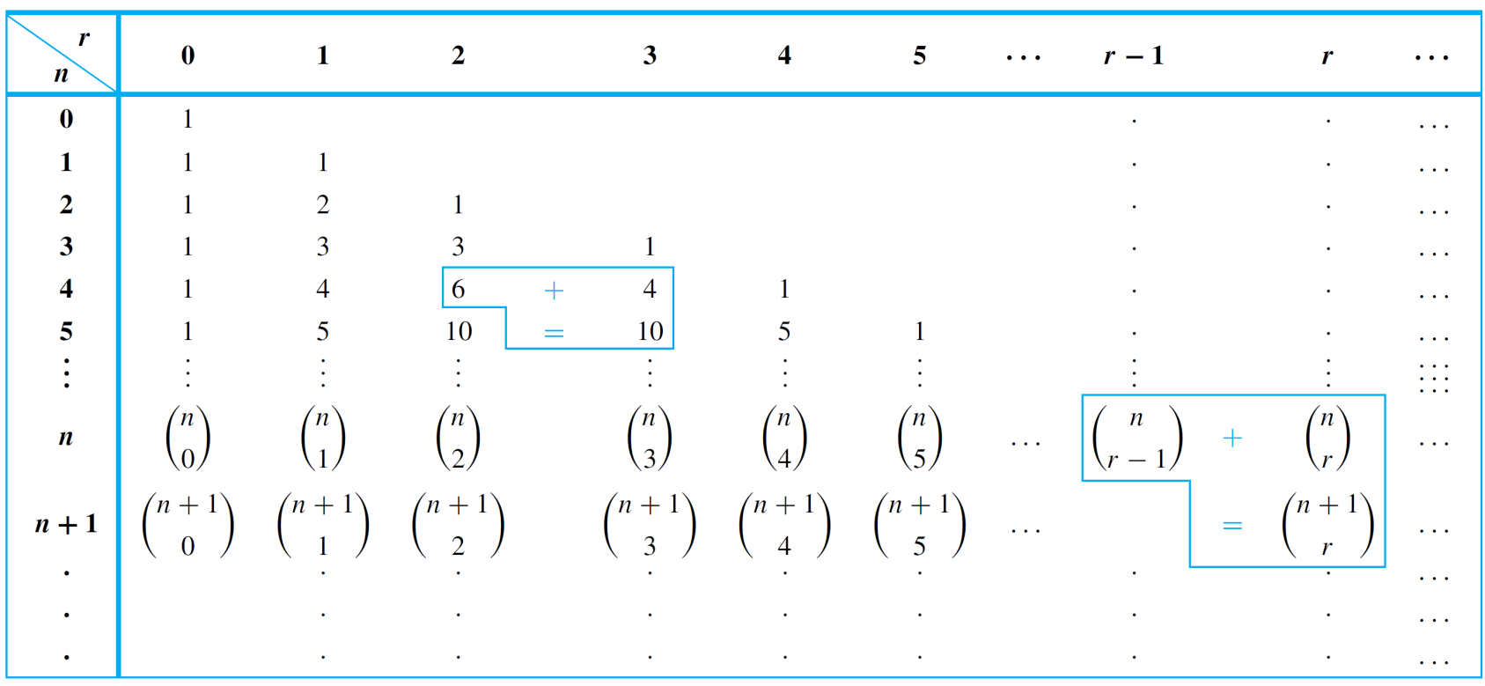

Pascal’s Formula
Pascal’s triangle, shown in Table 9.7.1, is a geometric
version of Pascal’s formula.
It has generally been known as Pascal’s triangle.
Pascal’s Triangle for
Table 9.7.1

Slide 16

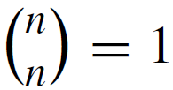

Pascal’s Formula
Each entry in the triangle is a value of
Pascal’s formula translates into the fact that the entry in row n + 1, column r equals the sum of the entry in row n, column r – 1 plus the entry in row n, column r.
That is, the entry in a given interior position equals the sum of the two entries directly above and to the above left. The left-most and right-most entries in each row are 1 because
by Example 1 and . .

Slide 17
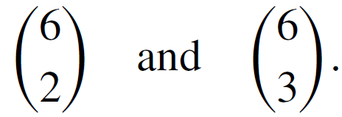
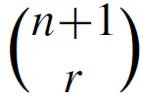
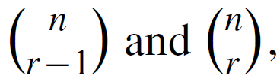
Example 3 – Calculating ( ) Using Pascal’s Triangle
n
r
Use Pascal’s triangle to compute the values of
Solution:
By construction, the value in row n, column r of Pascal’s triangle is the value of , for every pair of positive integers n and r with r ≤ n.
By Pascal’s formula, can be computed by adding together which are located directly above and
above left of .

Slide 18
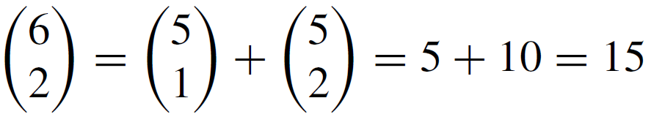
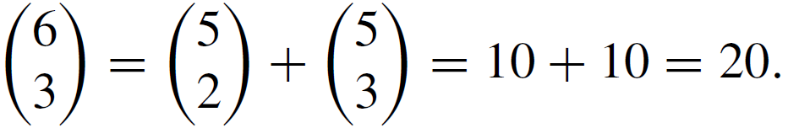
Example 3 – Solution
cont’d
Thus,
and

Slide 19
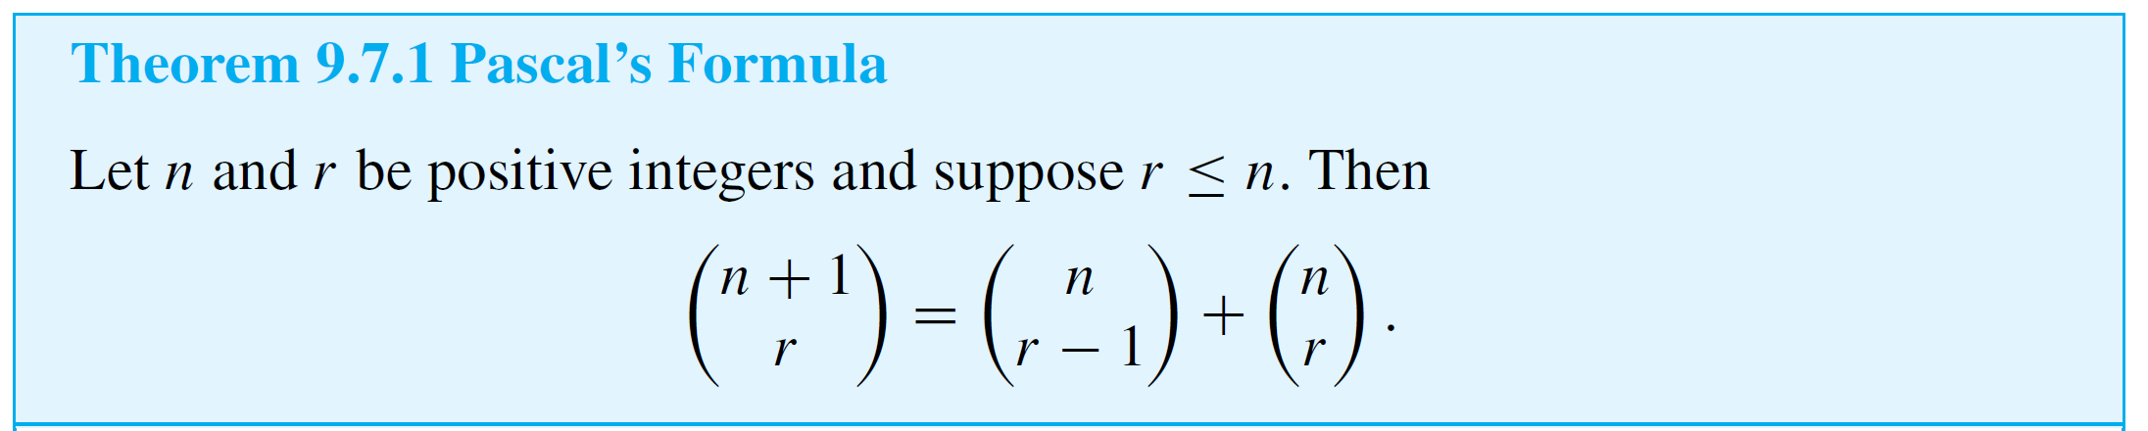
Pascal’s Formula
Pascal’s formula can be derived by two entirely different arguments. One is algebraic; it uses the formula for the number of r-combinations obtained in Theorem 9.5.1.
The other is combinatorial; it uses the definition of the number of r-combinations as the number of subsets of size r taken from a set with a certain number of elements.

Slide 20



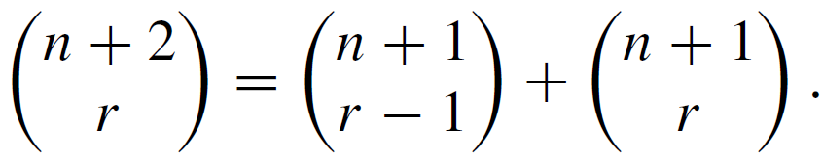
Example 4 – Deriving New Formulas from Pascal’s Formula
Use Pascal’s formula to derive a formula for in terms of values of , and
Assume n and r are nonnegative integers and 2 ≤ r ≤ n.
Solution:
By Pascal’s formula,

Slide 21
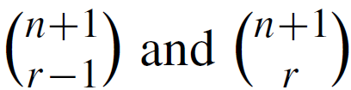
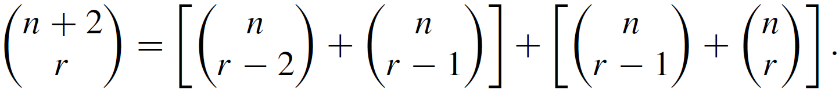
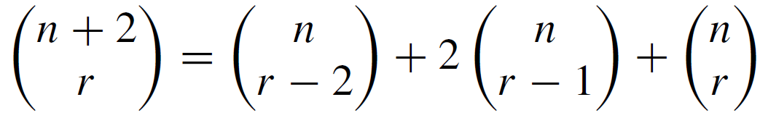
Example 4 – Solution
cont’d
Now apply Pascal’s formula to and substitute into the above to obtain
Combining the two middle terms gives
for all nonnegative integers n and r such that 2 ≤ r ≤ n.

Slide 22
The Binomial Theorem

Slide 23
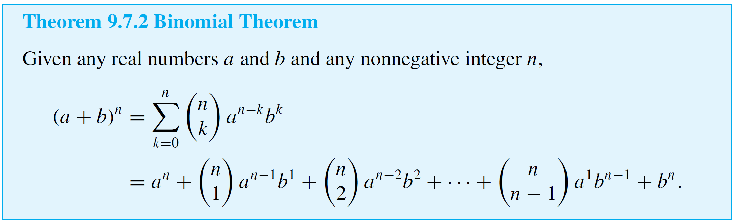
The Binomial Theorem
In algebra a sum of two terms, such as a + b, is called a binomial.
The binomial theorem gives an expression for the powers of a binomial (a + b)^{n}, for each positive integer n and all real numbers a and b.

Slide 24
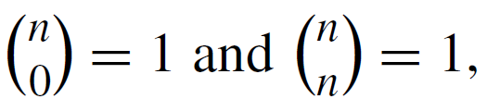

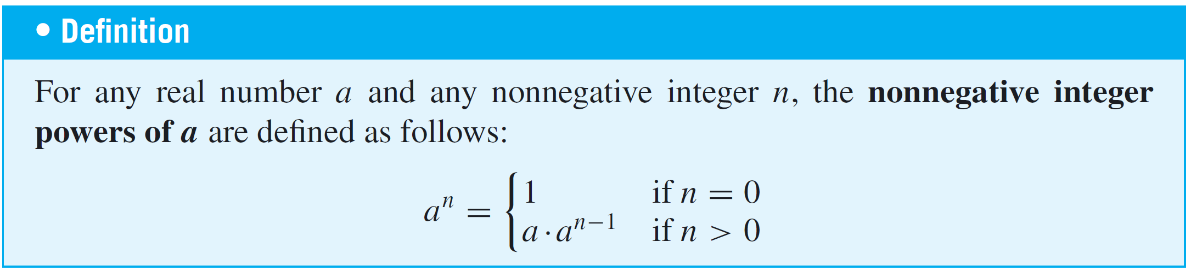
The Binomial Theorem
Note that the second expression equals the first because
for all nonnegative integers n, provided
that

Slide 25
The Binomial Theorem
If n and r are nonnegative integers and r ≤ n, then is called a binomial coefficient because it is one of the coefficients in the expansion of the binomial expression
(a + b)^{n}.

Slide 26


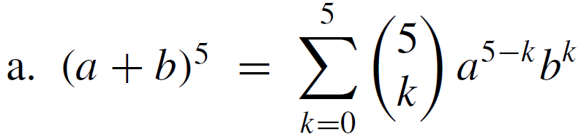
Example 5 – Substituting into the Binomial Theorem
Expand the following expressions using the binomial theorem:
a. b.
Solution:
a.

Slide 27

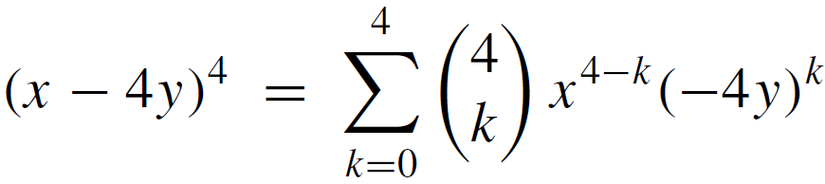
Example 5 – Solution
cont’d
b. Observe that
So let a = x and b = (–4y), and substitute into the
binomial theorem.

Slide 28
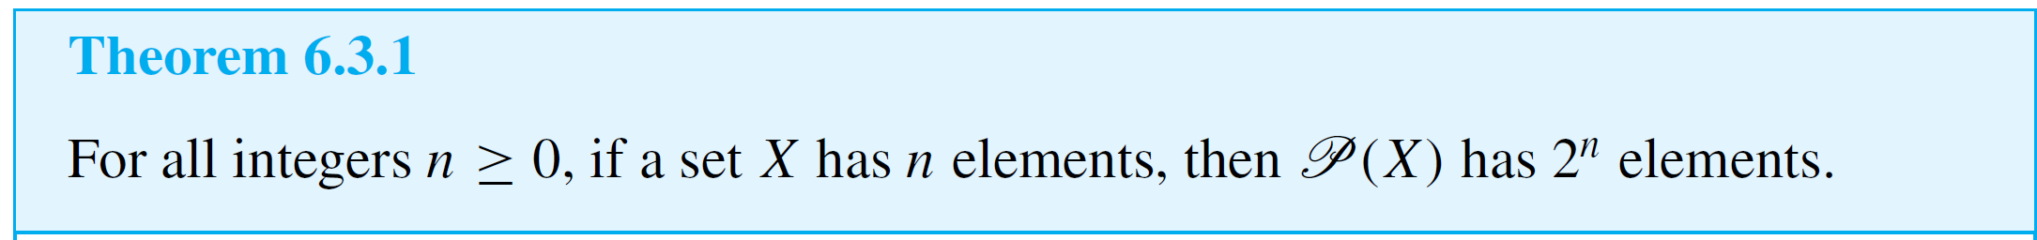
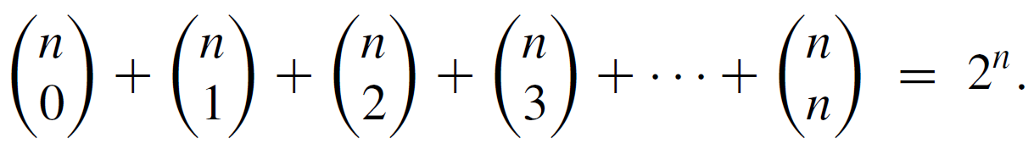
Example 7 – Using a Combinatorial Argument to Derive the Identity
According to Theorem 6.3.1, a set with n elements has 2^{n} subsets.
Apply this fact to give a combinatorial argument to justify the identity

Slide 29

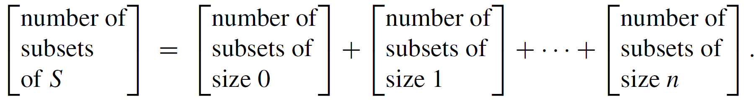

Example 7 – Solution
Suppose S is a set with n elements. Then every subset of S has some number of elements k, where k is between 0 and n.
It follows that the total number of subsets of
can be expressed as the following sum:
Now the number of subsets of size k of a set with n elements is

Slide 30
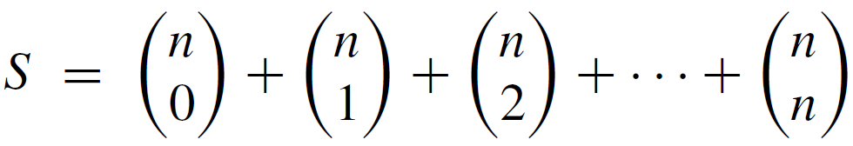
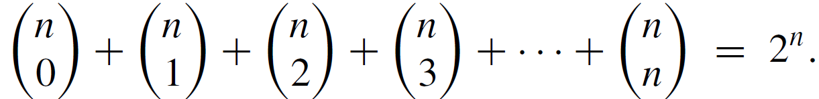
Example 7 – Solution
cont’d
Hence,
the number of subsets of . .
But by Theorem 6.3.1, S has 2^{n} subsets. Hence

Slide 31
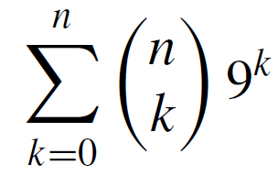
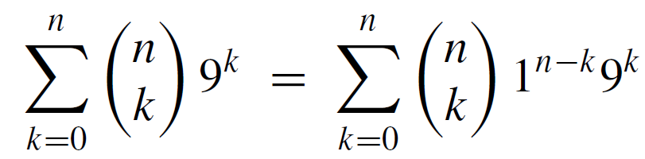

Example 8 – Using the Binomial Theorem to Simplify a Sum
Express the following sum in closed form (without using a summation symbol and without using an ellipsis · · · ):
Solution:
When the number 1 is raised to any power, the result is still 1. Thus

